Slide 1
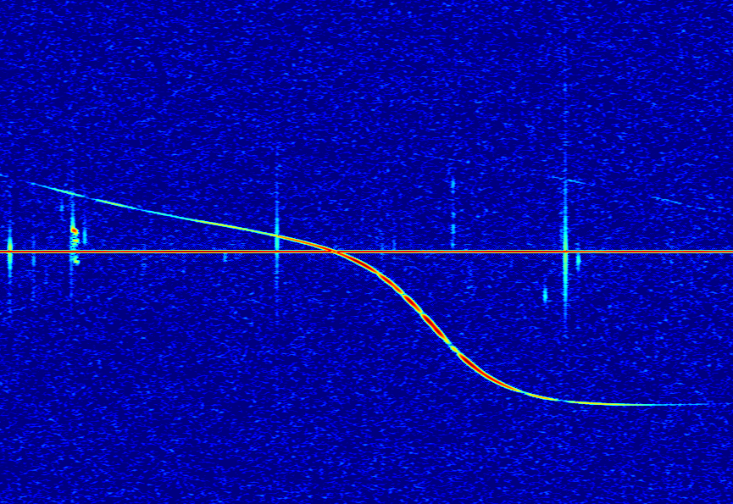

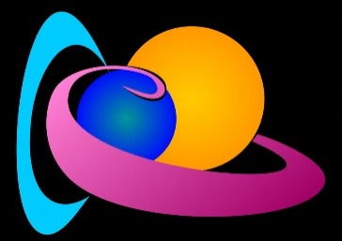
Radio emissions of auroral origin observed by the BRAMS network during the Mother’s Day geomagnetic storm
Hervé Lamy & the BRAMS team
Royal Belgian Institute for Space Aeronomy
IMC 2024 – Kutná Hora – 20/09/2024

Slide 2
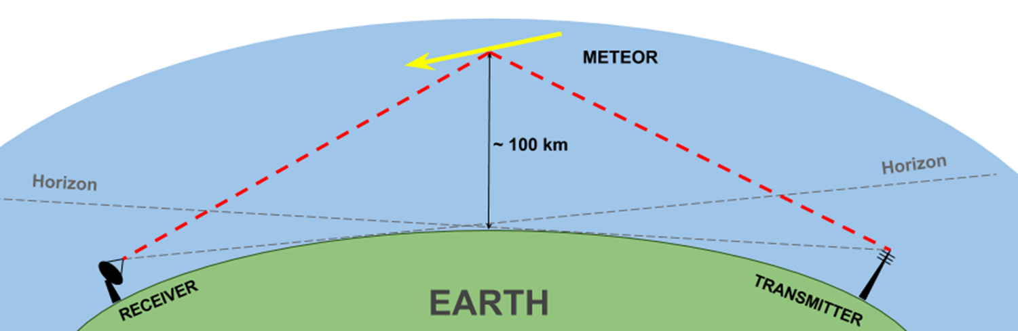
Forward scatter radio observations of meteors

Slide 3
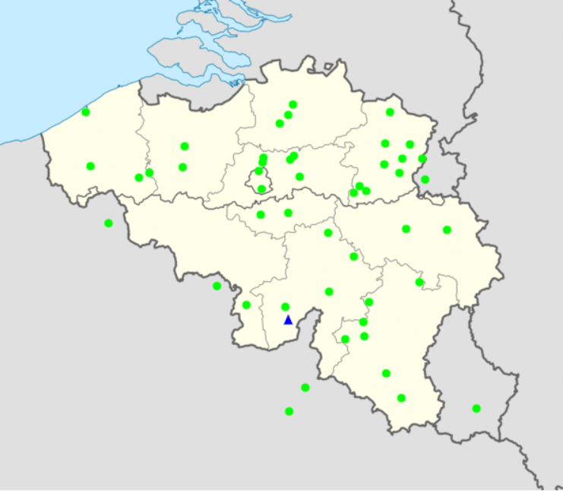
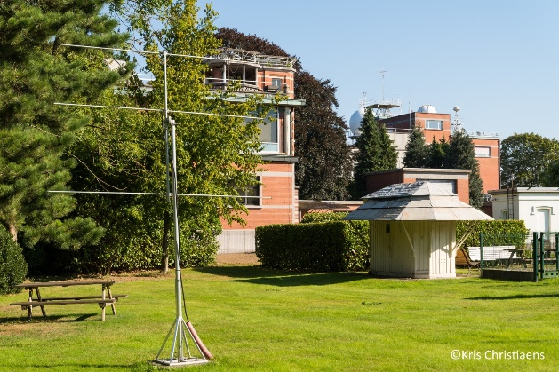
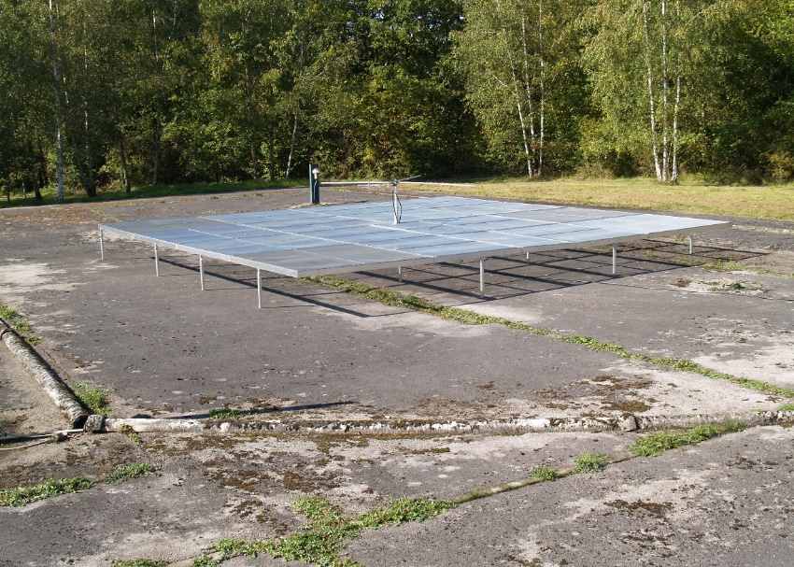
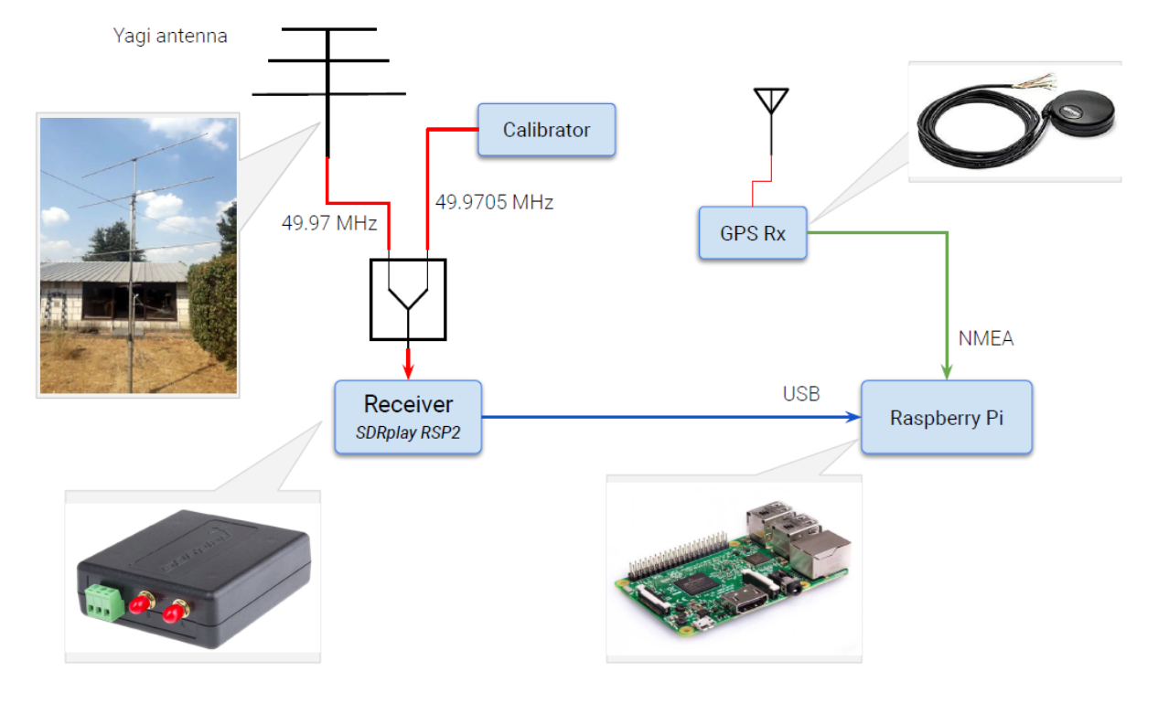
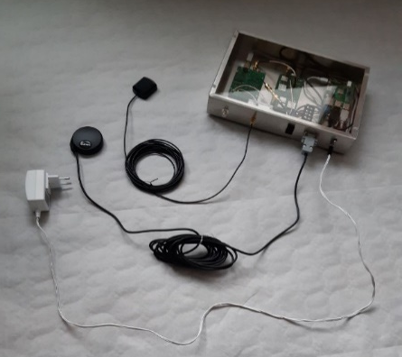
The BRAMS network
A dedicated Transmitter
Located in Dourbes (blue triangle) :
f=49.97 MHz
CW with no modulation
Radiated power: 340 Watts
circular polarization towards zenith
50 Receiving stations
Green dots
3-elements Yagi antennas
Synchronized using GPS clocks

Slide 4
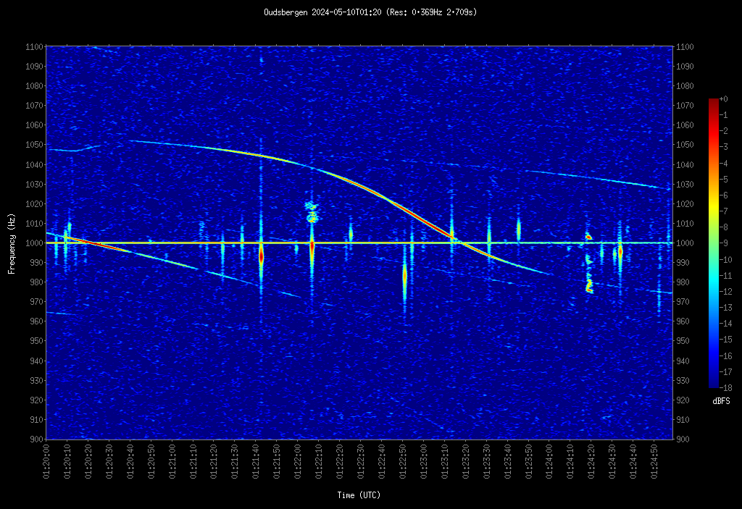
BRAMS data at BEOUDS at 01H20 UT on 10/05/24
Typical spectrogram at BEOUDS with a really good SNR
900-1100 Hz

Slide 5
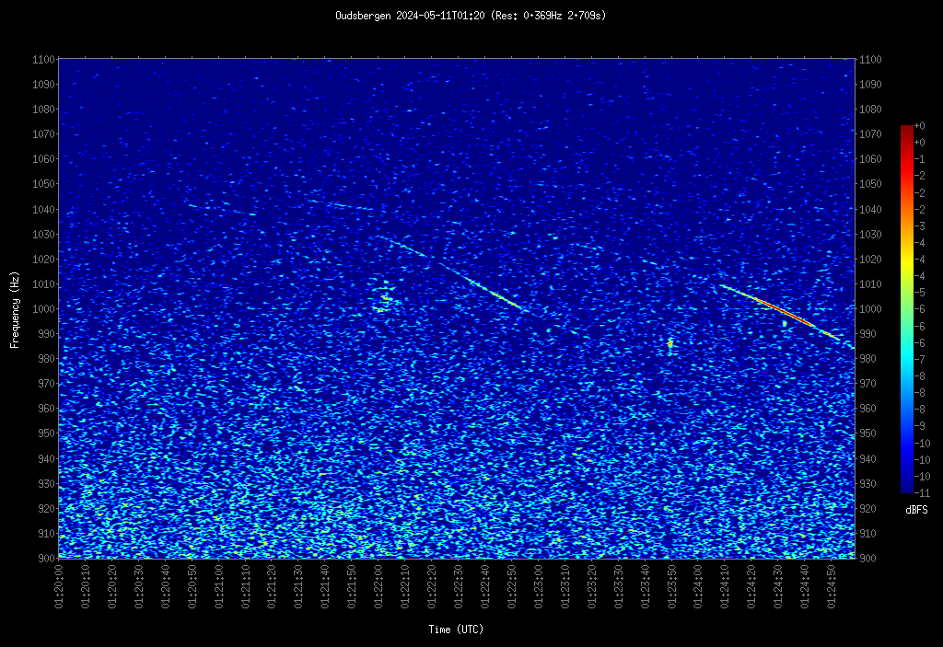
BRAMS data at BEOUDS at 01H20 UT on 11/05/24
900-1100 Hz
During the aurora, usual signals were drawn into “noise”

Slide 6
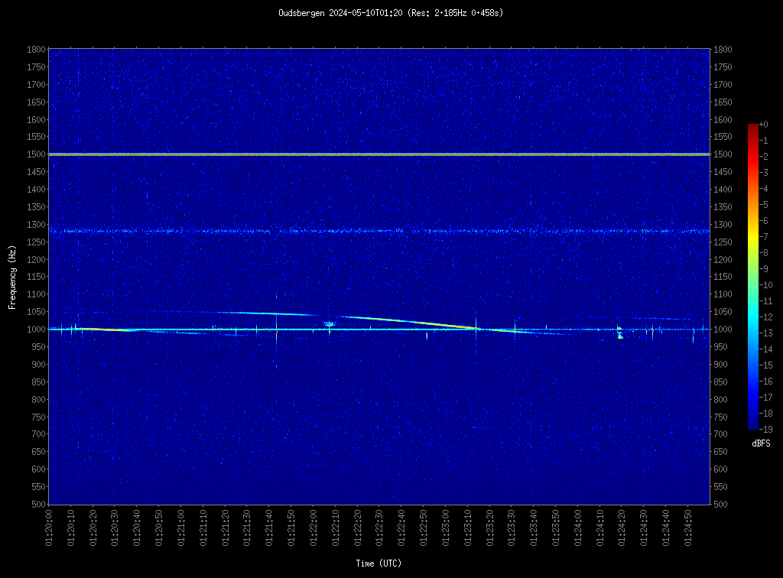
Noise PSD integrated in [800-900] Hz
All interesting signal appear in [900:1100] Hz (in between red lines)
BRAMS calibrator signal at 1500 Hz
Parasitic signal near 1300 Hz
Noise is usually measured in [800:900] Hz (green band)
500-1800 Hz

Slide 7
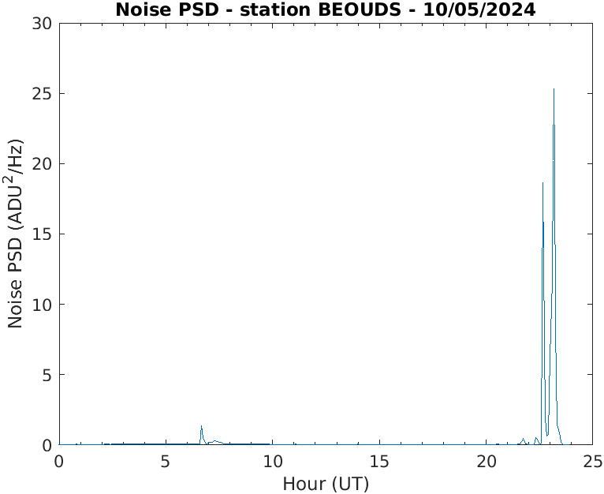
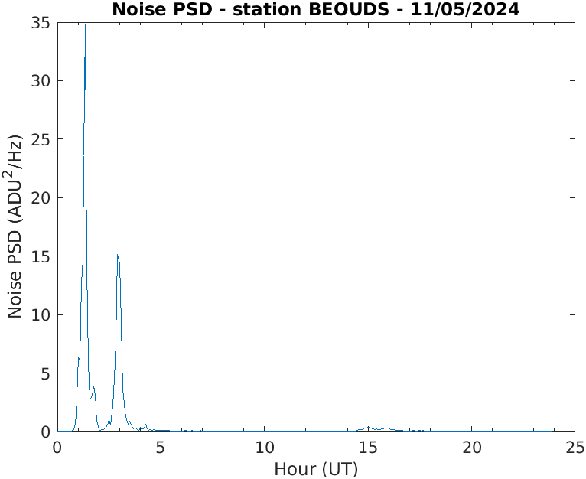
Noise PSD integrated in [800-900] Hz
During the aurora, the “noise” level increased by a factor ∼ 50-100

Slide 8
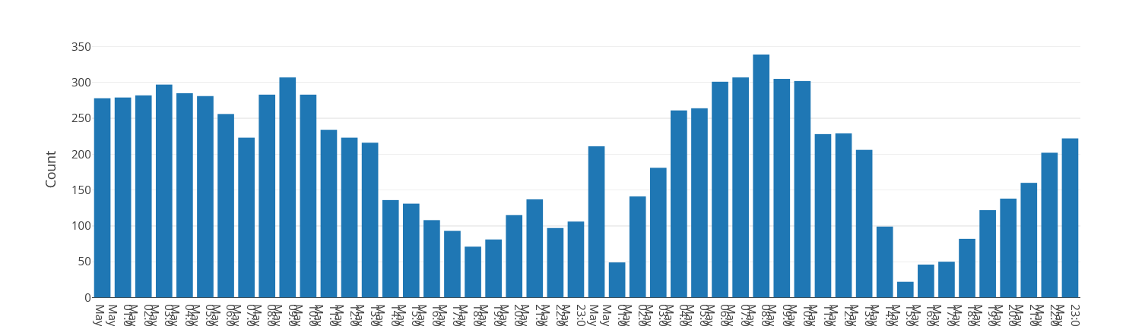
Impact visible on meteor counts
10 May
11 May

Slide 9
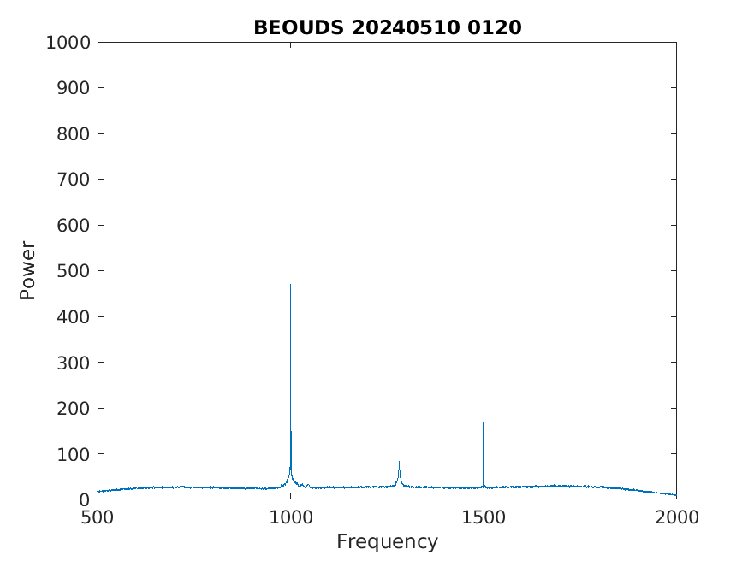
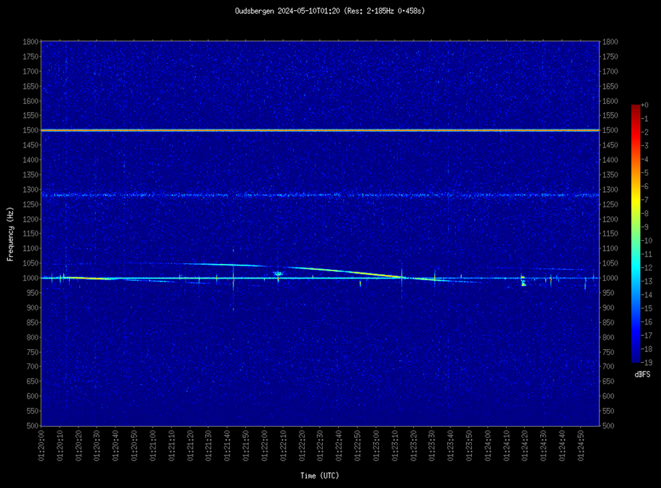
Spectral distribution in normal conditions

Slide 10
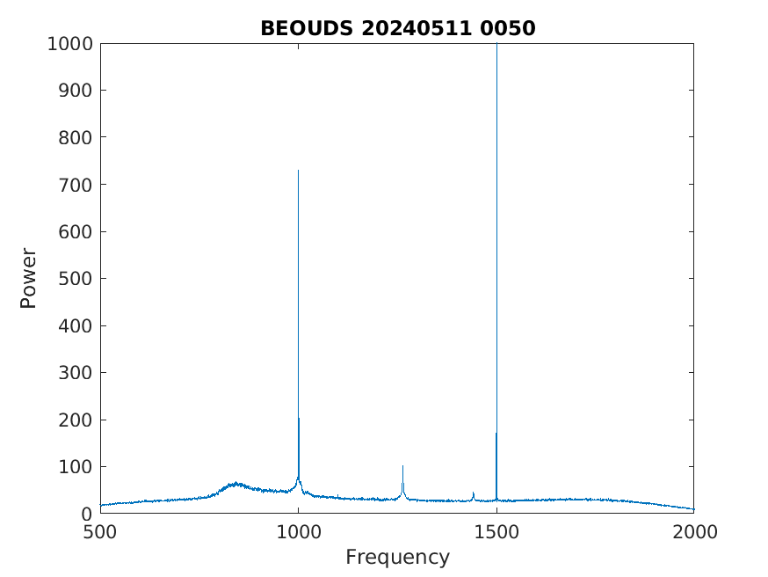
Spectral distribution during the aurora
Very strong enhancement of the “noise”
Width ≤ 1 Khz
Very dynamic with sometimes multiple sub-peaks

Slide 11
So, what did we see?
According to Labelle (2023)’s review paper, there are 4 types of radio auroral emissions observed from the ground before
Fine structures, width and emissions in MHz may suggest cyclotron harmonic emissions
At 50° latitude, |B| ∼ 44000-42000 nT at 100-200 km altitude giving a cyclotron frequency eB/m_{e} of ∼ 7.5-7.7 MHz. Is this possible that we have detected cyclotron harmonic emissions?
None of them has been observed at ∼ 50 MHz
Labelle (2023)

Slide 12
Additional work
Looking at the structure of these emissions at several stations with the largest separation in latitude and longitude
Looking at the structure of these emissions with a time resolution < 5 mins
Looking at the polarization values at our station in Humain where we have a crossed Yagi antenna.
Looking at integrated total power of these emissions (using the values of the BRAMS calibrator). However, the gain of the antenna is unknown since we do not know where exactly the aurora was located
Hence … looking at optical observations from several meteor cameras in Belgium

Slide 13
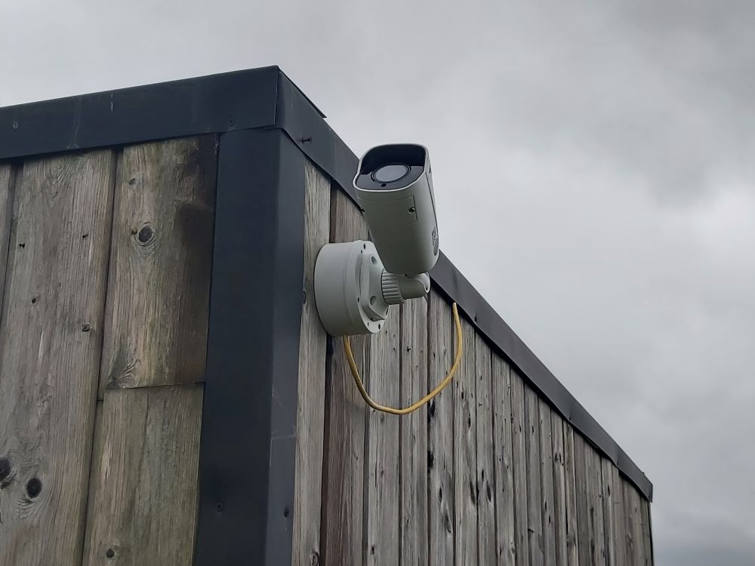
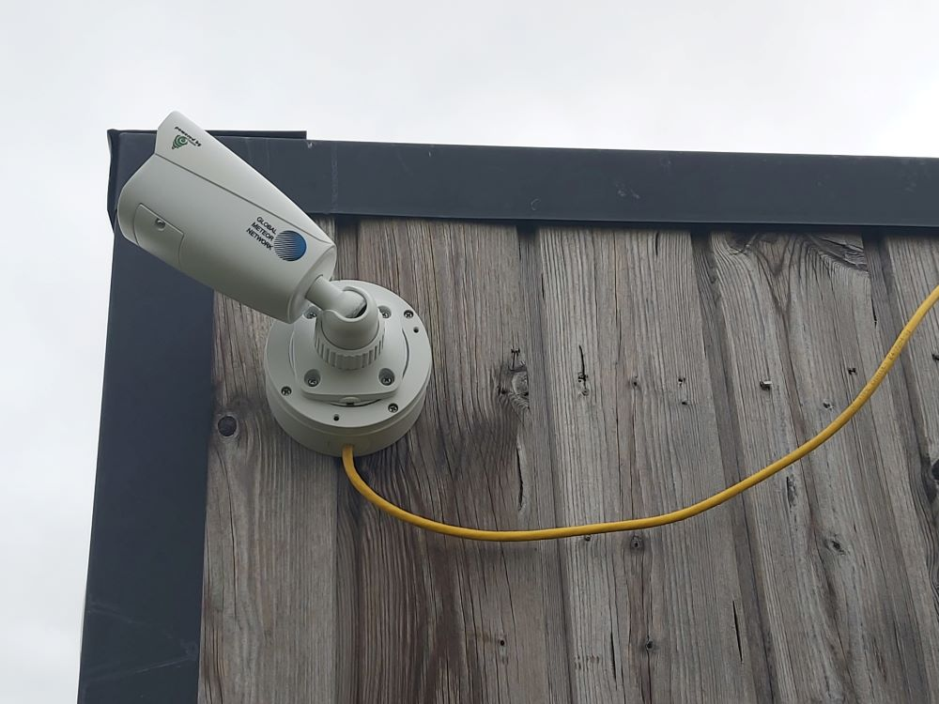
Meteor cameras observations
Camera from the GMN network installed in Humain

Slide 14

Timelapse movie from 10-11 May 2024
Credit: Denis Vida (GMN PI)

Slide 15
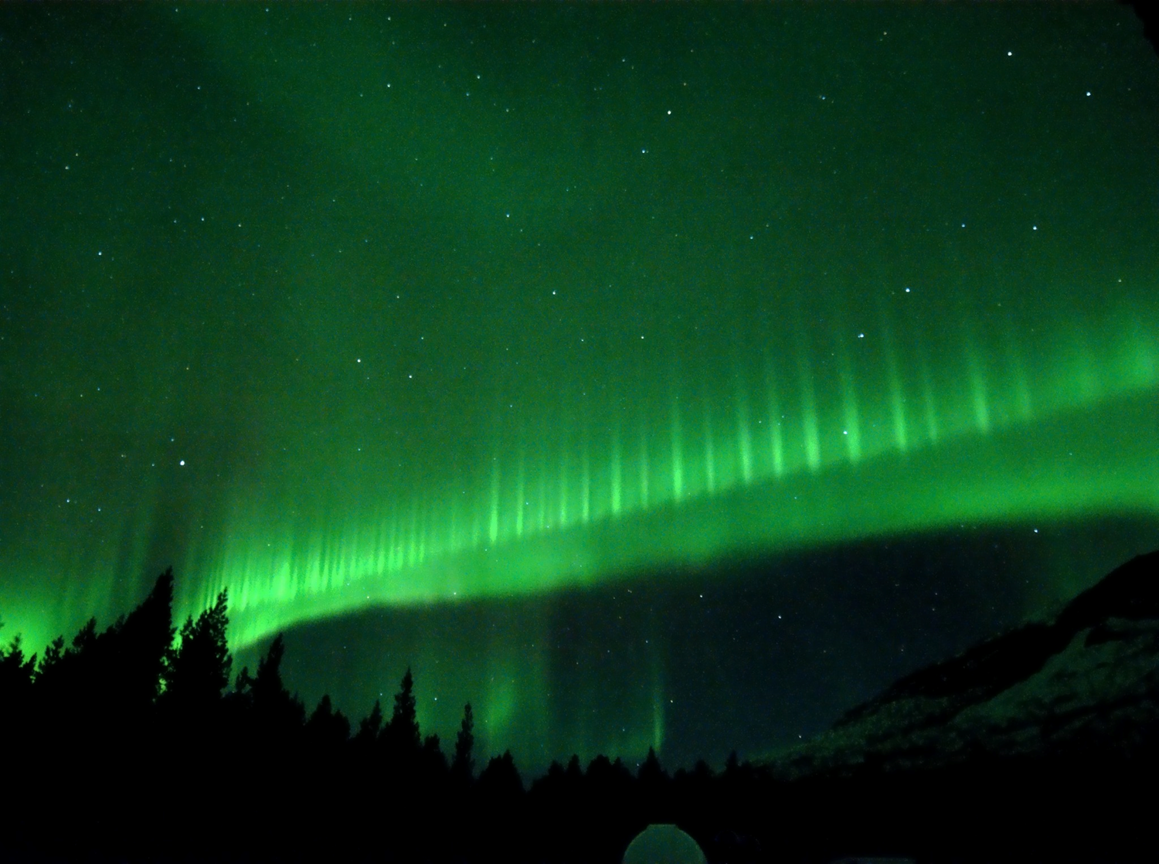
Thank you for your attention

